Slide 1

OBJECT ORIENTED MODELLING & DESIGN (OOMD)
SOFTWARE TESTING
UE19CS400SB
Prof. Venkatesh Prasad/Ms.Sumy Joseph
venkateshprasad@pes.edu
Department of Computer Science &Engineering

Slide 2
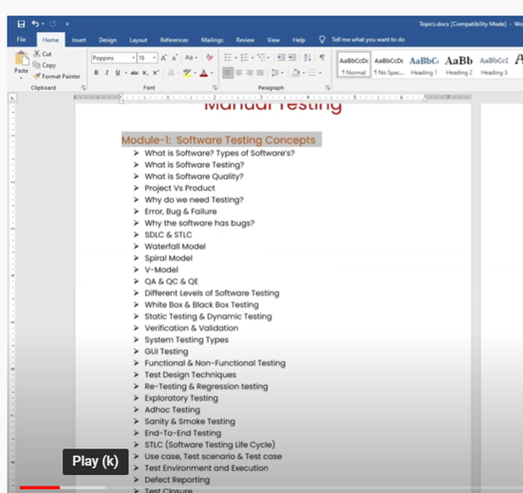
Software Testing Concepts

Slide 3
Unit #: 1 – Introduction to Software Quality and Testing (6 Hours)
What is Software Quality?
Software Quality Concepts
Verification and Validation
Software Quality Assurance
Cost of Quality

Slide 4
SOFTWARE
Software is a collection of Computer Programs that performs a task.
Eg) Mobile without Apps
Prgrams- Set of Instructions
Softwares- 1. System Softwares (Device Drivers, Utility Files, (Docs) ,Operating System,Servers)
- Will helps to run the Systems
Accessories connected to Computer(Mouse/Keyboard/Printer)
2. Programming Software-Compilers, Debuggers, Interpreters
-> Input-> Process->Output { Internal Process}
->Internal Softwares
3. Application Software- The users will use the Software
Web Applications ( Amazon/Flipkart)
Mobile Applications (Playstore Downloads)
Desktop Applications ( MS word,Notepad)

Slide 5
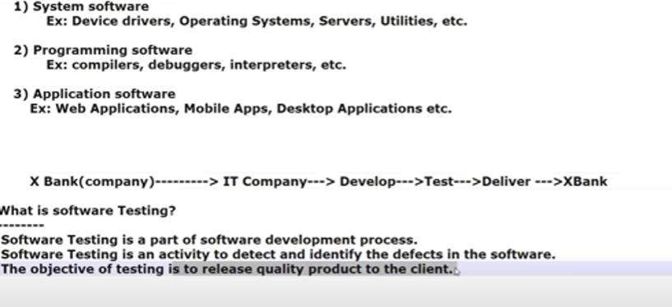
Software Types

Slide 6
Software Quality
Bug Free
Delivered On Time
Within Budget
Meet the Requirements
Maintainable

Slide 7
PRODUCT Vs PROCESS
PROJECT: If Software application developed for specific customer/specific customer requirements ,then it is called PROJECT. That project is only used by that specific organization.
Ex) Finacle
Service Based Companies (TCS, Accenture, Infosys)
PRODUCT: If Software application developed for the market requirements, and that is used by multiple customer then it is called PRODUCT.
Ex) Mobile Apps, Watzapp, MS Word, PPT
Product Based Companies (Microsoft, Google, Oracle)

Slide 8
What is Software Quality?
Software quality is defined as a field of study and practice that describes the desirable attributes of software products.
There are two main approaches to software quality: defect management and quality attributes.
“fitness of purpose” isn’t a completely satisfactory definition of quality.
ISO/IEC 25010:2011 Software Quality Model : This standard describes a hierarchy of eight quality characteristics, each composed of sub-characteristics:
-> Functional suitability
-> Reliability
-> Operability
-> Performance efficiency
-> Security
-> Compatibility
-> Maintainability
-> Transferability

Slide 9
Quality Concepts
Additionally, the standard defines a quality-in-use model composed of five characteristics:
Effectiveness
Efficiency
Satisfaction
Safety
Usability

Slide 10
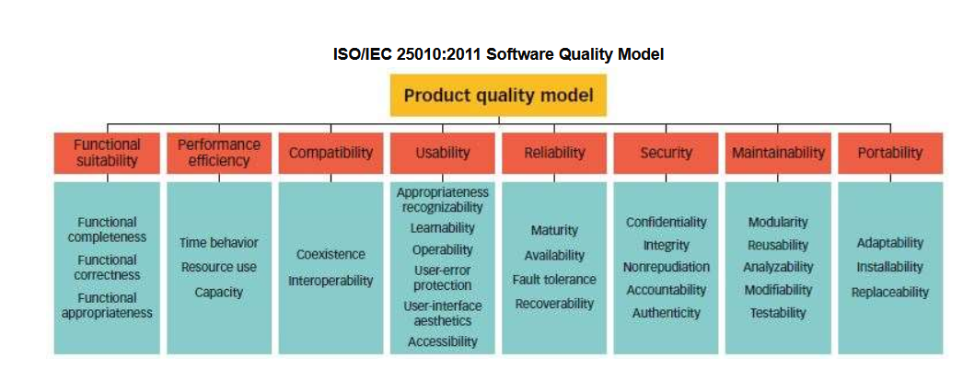
Software Quality Model

Slide 11
Quality Concepts
According to PMBOK, quality is a conformance to standards or requirements.
ISO 9000 defines it as the
“totality of features and characteristics of a product or service that bear on its ability to satisfy stated and implied needs.”
In some industries, government agencies, and educational institutions, quality is described as
Fitness for use.
Fitness for purpose
Customer satisfaction,
Conformance to requirements/specifications

Slide 12
Quality Concepts
Dr. Herald Kerzner States that most organizations today view quality as a process rather than product. It is a continuous process of improvement and the use of lessons learned to enhance the manufacturing of products or services in order to
Retain existing customers
Win back lost customers
Win new customers
Notes:
Dr. Kerzner is a globally recognized expert on project, program, and portfolio management, total quality management, and strategic planning and the author of the best-selling books about project management

Slide 13
Quality Concepts
Deming’s PDCA Cycle (Plan, Do, Check, and Act) is another well known continuous improvement process. Deming states that:
Plan Improvements to present practices (Establish objectives and processes required to deliver the desired results.)
Do Implement the plan (Carry out the objectives from the previous step.)
Check Test to see if the desired results are achieved (Data is compared to the expected outcomes to see any similarities and differences. )
Act Implement the corrective action (Also called "Adjust", this act phase is where a process is improved. )
Notes:
William Edwards Deming (October 14, 1900 – December 20, 1993) was an American engineer, statistician, professor, author, lecturer, and management consultant.

Slide 14
What is a Software Quality?
Conformance to requirements
Lack of defects
Low defect rate (# of defects/size unit)
High reliability (number of failures per N hours of operation)
Probability of failure-free operation in a specified time
Measured as Mean Time To Failure (MTTF)
this metric indicates how long the system operates until failure.
MTBF (Mean Time Between Failures) describes the time between two failures
MTTF (Mean Time To Failure) describes the time up to the first failure.

Slide 15
Generic reasons for software failure
Uniqueness of the software product
High Complexity
Limited Opportunity to detect bug
Environment in which software is developed
Requirement of teamwork

Slide 16
Quality Factors
Correctness
Reliability
Efficiency
Integrity
Usability
Maintainability
Flexibility
Testability
Portability
Interoperability
Reusability

Slide 17
Quality Management
According to PMBOK,
“Project Quality Management includes the processes required to ensure that the project will satisfy the needs for which it was undertaken.
It includes “all activities of which the overall management function that determine the quality policy, objectives, and responsibilities and implements them by means such as quality planning, quality control, quality assurance, and quality improvement, within the quality system.”
Project Quality Management must address both the management of the project and product of the project.

Slide 18
Quality Management
Project Quality Management consists of the following major processes
Quality Planning (Planning Process)
Quality Assurance (Execution Process)
Quality Control (Control Process)
QA is process-oriented, and it focuses on preventing quality issues. QC is product-oriented and focused on identifying quality issues in manufactured products. ... QA involves the actions which create the product, while QC is focused on the resulting product.
Notes:
Quality control can be defined as "part of quality management focused on fulfilling quality requirements." While quality assurance relates to how a process is performed or how a product is made, quality control is more the inspection aspect of quality management.

Slide 19
Cost of Quality
The cost of quality is the total price of all efforts to achieve product or service quality. This includes the work to build a product or service that conforms to the requirements and all work resulting non-conformance to the requirements.
A typical project should have a goal of 3 to 5 percent of the total value devoted to the cost of a quality program.

Slide 20
Cost of Quality
Prevention cost
Appraisal Cost
Internal Failure cost
External failure cost

Slide 21
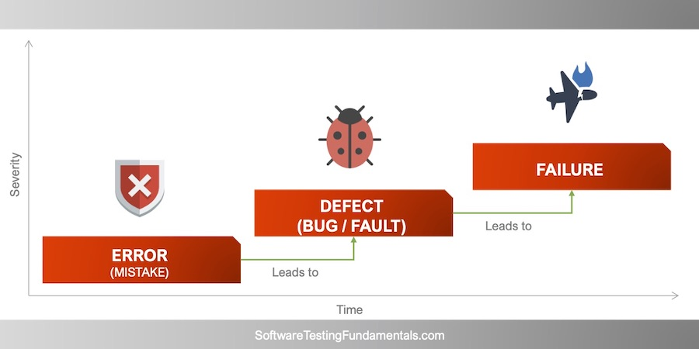
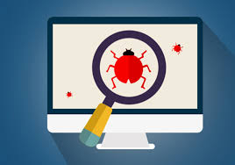
Reasons for Testing
Software contains defects
Defects may cause software failure
Failure can cause disaster
Testing ensures quality of software
Testing accelerates software development.
……...And much more!!!

Slide 22
ERROR/BUG/FAILURES
ERROR: Human Mistake, incorrect human action.
Developer has made some mistake ,typing something wrong
BUG: Deviation from the expected behavior and actual behavior (Defect)
Bug and Failure related to application
Gmail: Valid user name and valid password (Login)
If we pass invalid data, it is a mismatch
FAILURE: Deviation identified by the end user is Failure (Production Environment)

Slide 23
Why Failures in Software
Miscommunication/No Communication
Complexity of the Software
Programming Error (Responsibility of the Developer)- Incorrect Output
Frequently changing Requirements
Lack of skillset : Tester skillset

Slide 24
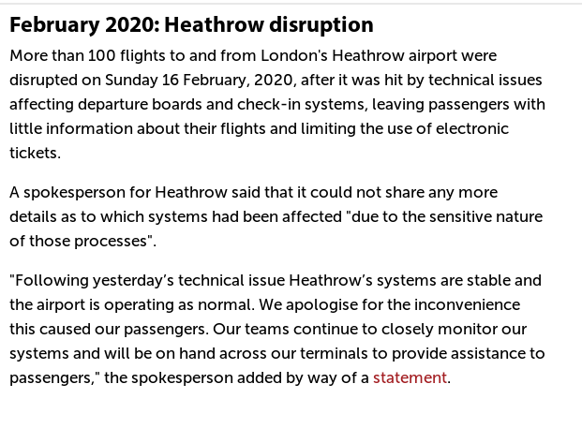
FAMOUS FAILURES

Slide 25
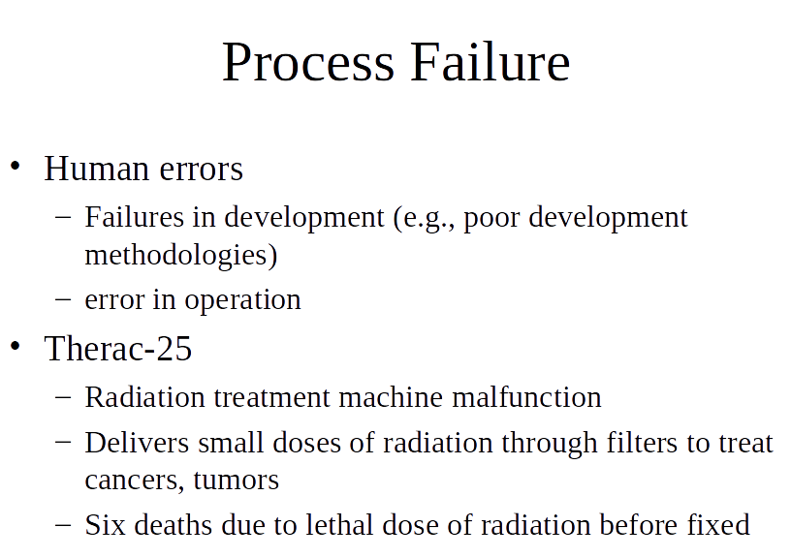

Slide 26
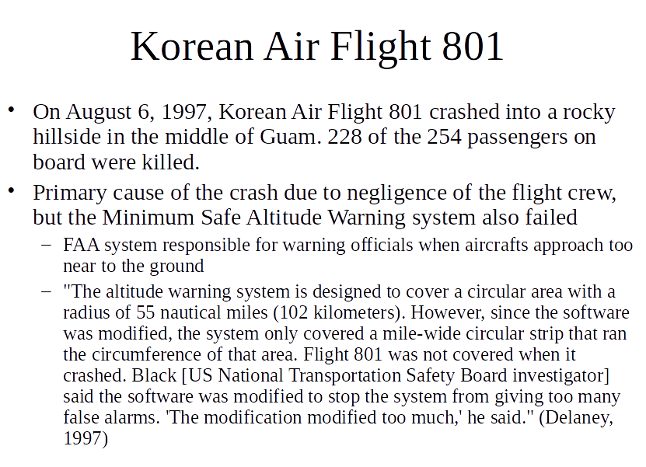

Slide 27

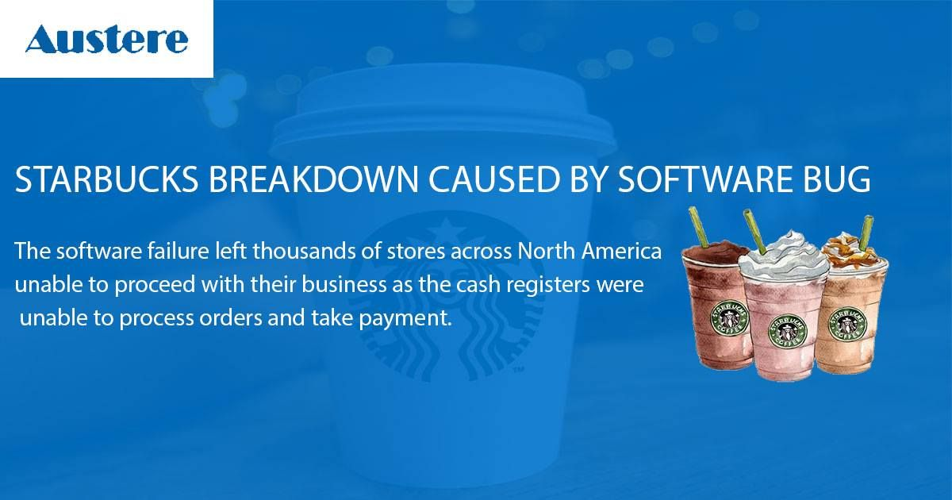
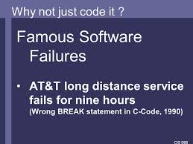
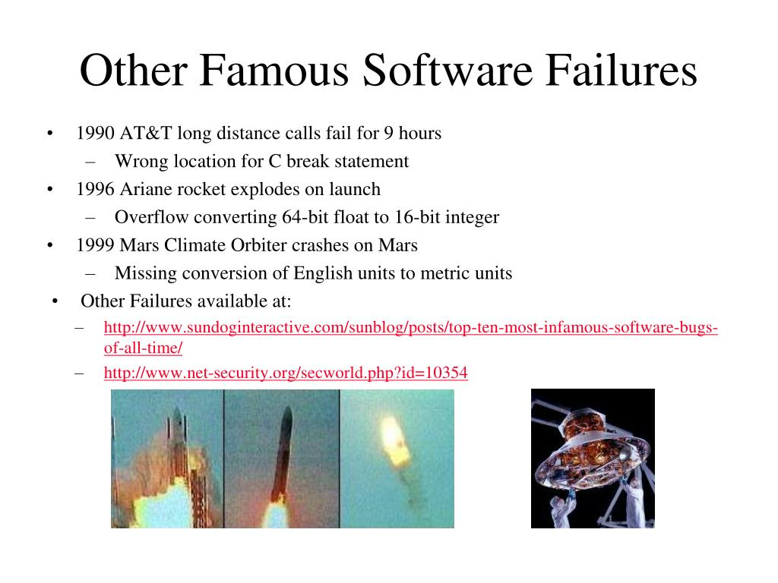
Famous Software Testing Failures Examples
Ariane 5 Flight 501
Soviet Gas Pipeline Explosion
https://raygun.com/blog/costly-software-errors-history/

Slide 28
SO, DO THE SOFTWARE TESTING RIGHT
Testing has to be planned
Testing has to be performed in a reasonable way
Testing shall be independent of the Objective
Testing has to be managed.
SOFTWARE TESTING IS A FUNDAMENTAL PART OF THE PROFESSIONAL SOFTWARE DEVELOPMENT

Slide 29
SDLC

Slide 30
SDLC- Software Development Life Cycle
Process used by the Software Industry to deliver the project to the customer
3 Pillars
P- People
P- Process (Stages)
P- Product (Deliverables)
SDLC –Phases
Requirements Analysis -> Design->Development (Coding)-> Testing-> Implementation-> Maintenance
Software Development Life Cycle (SDLC) is a framework that defines tasks performed at each step in the development process.
Originated in the 1960s, SDLC is a structured, standardized set of processes for developing and maintaining business solutions.
From inception to completion, it details out; how to plan, build, and maintain specific software.

Slide 31
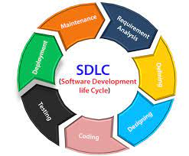
SDLC Phases

Slide 32
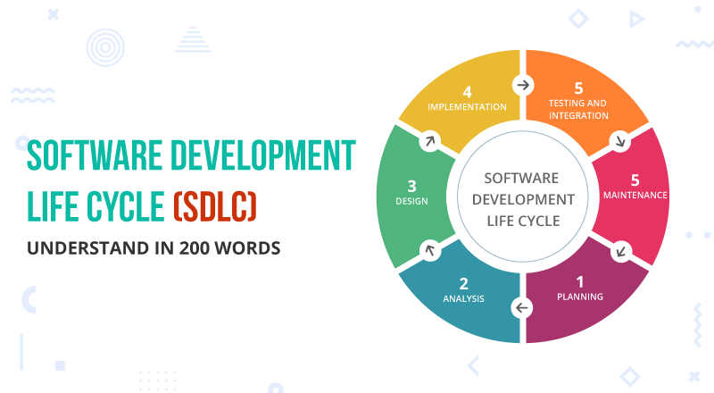
SDLC

Slide 33
Why SDLC?
Project Tracking and control
Increased visibility
Enhanced Development speed
Improved client relation
Decreased the project risk
To manage the project complexities, number of SDLC models was created like waterfall, incremental, Agile, Prototype, etc.
The method of implementing SDLC varies vastly between methodologies.
SDLC is a crucial consideration before the actual software development process.

Slide 34
It aims to:
Deliver high-quality system
Work efficiently with the existing and planned infrastructure
Maximize productivity
Provide strong management controls
Lower the cost the development

Slide 35
SDLC PHASES
Stage 1: Planning and Requirement Analysis
Requirement analysis is the most important and fundamental stage in SDLC. It is performed by the senior members of the team with inputs from the customer, the sales department, market surveys and domain experts in the industry.
Stage 2: Defining Requirements
Once the requirement analysis is done the next step is to clearly define and document the product requirements and get them approved from the customer or the market analysts. This is done through an SRS (Software Requirement Specification) document which consists of all the product requirements to be designed and developed during the project life cycle.

Slide 36
SDLC PHASES….
Stage 3: Designing the Product Architecture
SRS is the reference for product architects to come out with the best architecture for the product to be developed. Based on the requirements specified in SRS, usually more than one design approach for the product architecture is proposed and documented in a DDS - Design Document Specification.
A design approach clearly defines all the architectural modules of the product along with its communication and data flow representation with the external and third party modules.The internal design of all the modules of the proposed architecture should be clearly defined with the minutest of the details in DDS.

Slide 37
SDLC PHASES….
Stage 4: Building or Developing the Product
In this stage of SDLC the actual development starts and the product is built. The programming code is generated as per DDS during this stage.
Stage 5: Testing the Product
This stage is usually a subset of all the stages as in the modern SDLC models, the testing activities are mostly involved in all the stages of SDLC. However, this stage refers to the testing only stage of the product where product defects are reported, tracked, fixed and retested, until the product reaches the quality standards defined in the SRS.

Slide 38
SDLC PHASES….
Stage 6: Deployment in the Market and Maintenance
Once the product is tested and ready to be deployed it is released formally in the appropriate market.
Sometimes product deployment happens in stages as per the business strategy of that organization.
The product may first be released in a limited segment and tested in the real business environment (UAT- User acceptance testing).

Slide 39
PROCESS MODELS
1. WATERFALL MODEL
Traditional model
Linear Model
The Waterfall Model was the first Process Model to be introduced. It is also referred to as a linear-sequential life cycle model.
In a waterfall model, each phase must be completed before the next phase can begin and there is no overlapping in the phases.
In this Waterfall model, typically, the outcome of one phase acts as the input for the next phase sequentially.

Slide 40
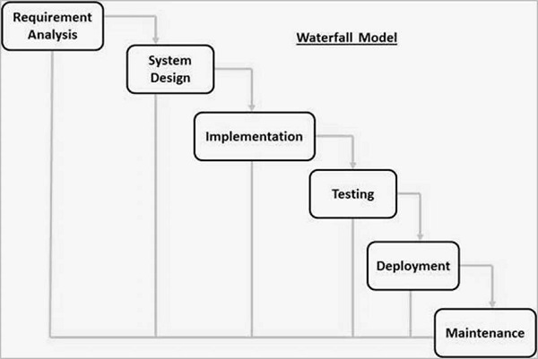
WATERFALL MODEL

Slide 41
Advantages of Waterfall Model
Quality of the Product will be Good
Since requirements changes are not allowed chances of finding bugs will be less
Initial investments is less since the testers are hired at the later stages
Preferred for smaller projects where requirements are freezed
Disadvantages
Requirement changes are not allowed
Backtracking is not possible
If there is defect in the requirement phases, it will continue in the later phases

Slide 42
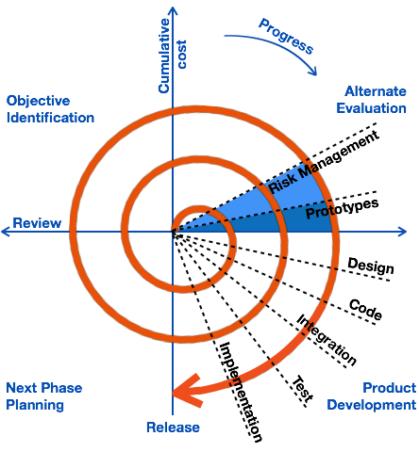
SPIRAL MODEL

Slide 43
SPIRAL MODEL…
The spiral model has four phases. A software project repeatedly passes through these phases in iterations called Spirals.
Identification
This phase starts with gathering the business requirements in the baseline spiral. In the subsequent spirals as the product matures, identification of system requirements, subsystem requirements and unit requirements are all done in this phase.
Design
The Design phase starts with the conceptual design in the baseline spiral and involves architectural design, logical design of modules, physical product design and the final design in the subsequent spirals.
Construct or Build
The Construct phase refers to production of the actual software product at every spiral. In the baseline spiral, when the product is just thought of and the design is being developed a POC (Proof of Concept) is developed in this phase to get customer feedback.

Slide 44
SPIRAL MODEL…
Evaluation and Risk Analysis
Risk Analysis includes identifying, estimating and monitoring the technical feasibility and management risks, such as schedule slippage and cost overrun.
After testing the build, at the end of first iteration, the customer evaluates the software and provides feedback.

Slide 45
Advantages of Spiral Model
Software will be released in multiple versions, Version Control Model
Testing is done in every cycle before go to the next cycle’
Customer will get to use the software for every module
Requirement Changes are allowed after every cycle before going to the next cycle.
Eg) Gmail(Compose mail, Sent Box-Dependency)
Disadvantages of Spiral Model
Requirement Changes are allowed in between cycle.
Internally we are following a waterfall model.
There is no testing in every phase.(every cycle , we have testing)

Slide 46
ITERATIVE MODEL….
Iterative process starts with a simple implementation of a subset of the software requirements and iteratively enhances the evolving versions until the full system is implemented.
At each iteration, design modifications are made and new functional capabilities are added.
The basic idea behind this method is to develop a system through repeated cycles (iterative) and in smaller portions at a time (incremental).

Slide 47
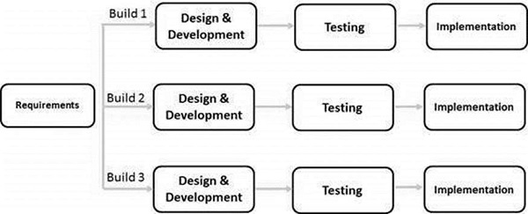
Iterative Model - Design

Slide 48
PROTOTYPING AND RAD (Rapid Application Development) MODEL
The Rapid Application Development Model was first proposed by IBM in the 1980s.
A software project can be implemented using this model if the project can be broken down into small modules wherein each module can be assigned independently to separate teams.
These modules can finally be combined to form the final product.
Development of each module involves the various basic steps as in the waterfall model i.e analyzing, designing, coding, and then testing, etc.
Prototype is a sample , blueprint of the software.
Get the initial requirements from customer->develop the prototype->show this to customer->we will start design, coding, testing
Eg) Model House

Slide 49
This model consists of 4 basic phases:
Requirements Planning – It involves the use of various techniques used in requirements elicitation like brainstorming, task analysis, form analysis, user scenarios, FAST (Facilitated Application Development Technique), etc.
User Description – This phase consists of taking user feedback and building the prototype using developer tools. In other words, it includes re-examination and validation of the data collected in the first phase.
Construction – In this phase, refinement of the prototype and delivery takes place. It includes the actual use of powerful automated tools to transform process and data models into the final working product.
Cutover – All the interfaces between the independent modules developed by separate teams have to be tested properly.

Slide 50
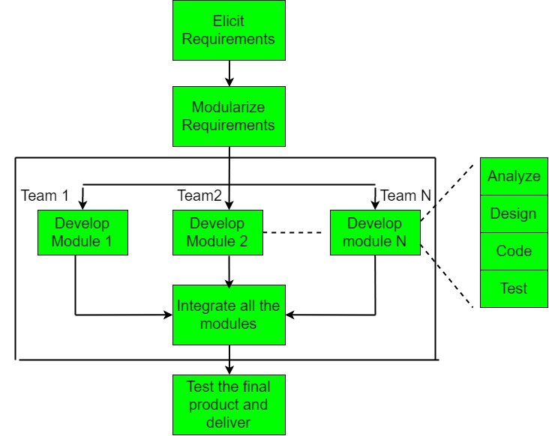

Slide 51
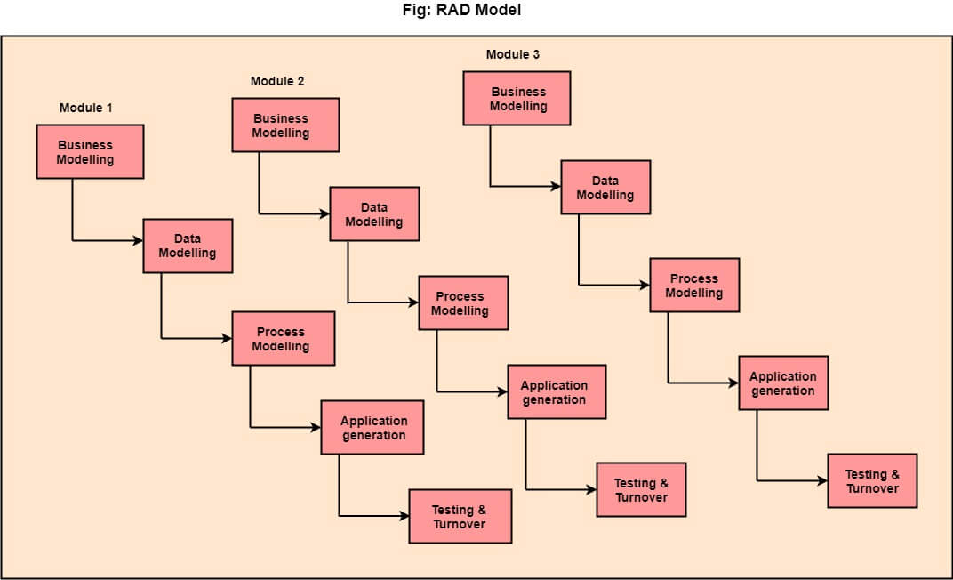
RAD MODEL

Slide 52
When to use RAD Model?
When the system should need to create the project that modularizes in a short span time (2-3 months).
When the requirements are well-known.
When the technical risk is limited.
When there's a necessity to make a system, which modularized in 2-3 months of period.
It should be used only if the budget allows the use of automatic code generating tools.

Slide 53
V –V MODEL (VERIFICATION & VALIDATION MODEL)
The model is similar to V shape
In every phase we conduct testing (All SDLC phases conducts testing)
BRS/CRS/URS : Documents contains the requirements from the customer
Business Unit will prepare the document
We conduct testing called UAT with this document
SRS and BRS? What is the difference?
Based upon SRS->HLD->LLD is prepared by designers
HLD->Main Modules of the application
LLD-> Low level modules

Slide 54
V- V MODEL
BRD->Business Unit People
SRS-> Product Manager/Project Managers
HLD & LLD->Designers
In V model, we have testing.
BRD->Reviews (To ensure the correctness and Completeness)
SRS, LLD,HLD ->Testing Techniques like Reviews, Walkthrough, Inspection (Testing the documents)
Static Testing : Testing the project related documents
Why static?
Review->
Walkthrough->
Inspection->

Slide 55
REVIEWS
Conducts on documents to ensure correctness and completeness
-> Requirements Review
->Design review
-> Code Review
->Test Plan review
-> Test Code Review

Slide 56
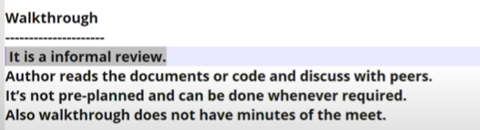
Walkthrough
Informal review, we don’t have any specific plan
Author- The person who has created the documents
Review the document with peers
Review : Only Author will be there
Walkthrough: Informal review With Peers

Slide 57
Inspection
It is most formal review Type
Minimum 3- 8 people sit together and review –Reader, Writer, Moderator
Inspection will have a proper schedule and proper intimation via email to the concerned tester /Developer

Slide 58
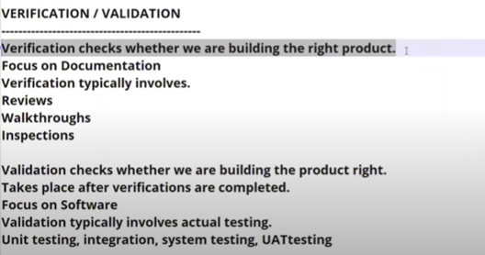
Verification and Validation
Dynamic Testing?
Testing the actual Software
Techniques: Unit Testing, Integration Testing,
UAT
Verification and Validtion?
Verification?-Will be done before software ready
Validation? – Will be done after Software is ready

Slide 59
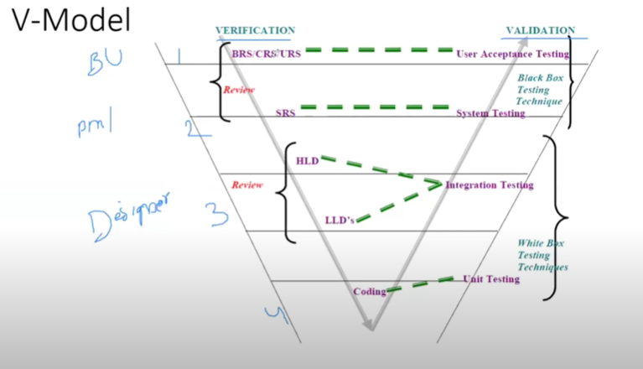
V –V MODEL

Slide 60
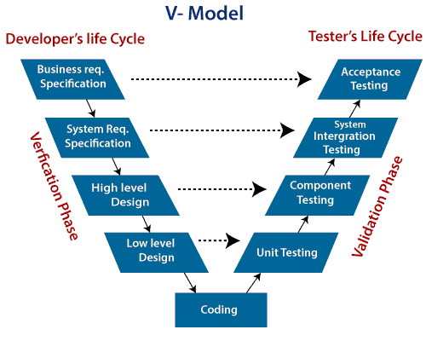
V-MODEL
V-Model also referred to as the Verification and Validation Model. In this, each phase of SDLC must complete before the next phase starts.
It follows a sequential design process same as the waterfall model.
Testing of the device is planned in parallel with a corresponding stage of development.

Slide 61
VERIFICATION AND VALIDATION
Verification: It involves a static analysis method (review) done without executing code. It is the process of evaluation of the product development process to find whether specified requirements meet.
Validation: It involves dynamic analysis method (functional, non-functional), testing is done by executing code. Validation is the process to classify the software after the completion of the development process to determine whether the software meets the customer expectations and requirements.

Slide 62
Advantages of V Model
Testing is involves in every phase, so less number of chances to get bugs in later phases
Disadvantages
Initial investment is high ,in every phase we need people developers,testers from beginning
Documentation is more
All activities should go in parallel

Slide 63
MODIFIED V MODEL
Modified V model recognizes that different parts of a product are in different stages of evolution
Each part enters the appropriate testing phase as unit testing, component testing and so on when the appropriate entry criteria are met

Slide 64
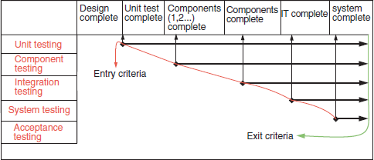
MODIFIED V -MODEL

Slide 65
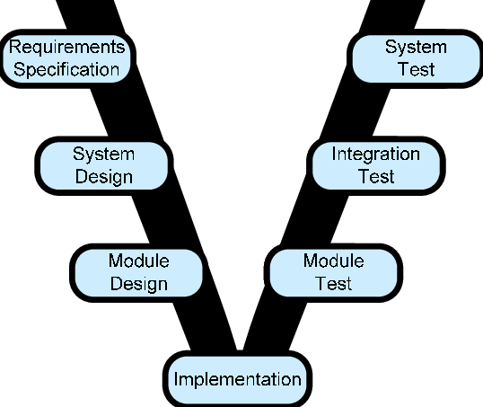
MODIFIED V MODEL

